Slide 1
Project Presentation of CO-OP Project at Industry (Module-2) (22CS421)
On
Acoustic Signal-Based Non- Intrusive Engine Fault Detection Using Mel-Spectrograms and Convolutional Neural Networks
Harimrat Singh
2210990395
Supervised By:
Dr. Gurpreet Singh
(Associate Professor)
Department of Computer Science and Engineering,
Chitkara University, Punjab

Slide 2
Abstract
Engine fault detection is important for maintaining vehicle performance and reliability. Traditional diagnostic systems rely on physical sensors and onboard diagnostic tools, which increase hardware complexity and cost. This project presents a non-intrusive engine fault detection system using acoustic signal processing and Convolutional Neural Networks (CNNs).
Engine sound recordings are preprocessed and converted into Mel-spectrograms to capture important frequency and temporal features. These spectrograms are then used as input to a CNN model for fault classification. The model automatically learns acoustic patterns associated with healthy and faulty engine conditions.
The proposed system was evaluated using 5-Fold Cross Validation and achieved approximately 86–87% validation accuracy. The results demonstrate that acoustic-based fault diagnosis can provide a cost-effective and scalable alternative to traditional sensor-based monitoring systems.
2

Slide 3
Introduction
Internal combustion engines generate characteristic acoustic patterns during operation. Under normal working conditions, these sound patterns remain relatively stable and consistent. However, when faults occur within the engine, noticeable changes appear in the frequency, amplitude, and overall acoustic behavior of the generated sound signals.
Faults such as misfires, knocking, belt wear, valve issues, or other mechanical abnormalities introduce distinct variations in engine sound. These variations can be captured using audio recordings and analyzed using acoustic signal processing techniques to identify abnormal engine conditions.
Traditional engine fault detection methods mainly rely on physical sensors, onboard diagnostic tools, or manual inspection procedures. Although effective, these approaches increase hardware complexity, maintenance cost, and implementation difficulty, making them less practical for low-cost and scalable monitoring applications.
This project proposes a non-intrusive engine fault detection system that automatically analyzes engine sound recordings to identify fault conditions. The proposed approach provides a cost-effective and practical alternative to conventional sensor-based diagnostic systems.

Slide 4
Problem Statement
Early detection of engine faults is important to prevent severe mechanical damage, reduce maintenance costs, improve fuel efficiency, and enhance overall vehicle reliability. Minor faults such as misfires, knocking, or component wear can gradually develop into major failures if they are not identified at an early stage.
Existing diagnostic approaches mainly depend on onboard diagnostic systems, physical sensors, or manual inspection procedures. Although these methods are effective, they have several practical limitations:
Require specialized hardware such as OBD tools and sensors
Increase system complexity and maintenance cost
Depend heavily on technical expertise and manual inspection
Not always accessible for low-cost or large-scale applications
In addition, conventional diagnostic systems may not be capable of identifying subtle acoustic changes during the initial stages of fault development.

Slide 5
Objectives
The primary objective of this project is to develop a non-intrusive engine fault detection system using acoustic signal processing and Convolutional Neural Networks (CNNs). The proposed system aims to identify engine faults automatically by analyzing engine sound recordings without requiring additional hardware sensors or complex diagnostic tools.
The specific objectives of the project are:
• To develop a practical and cost-effective engine fault detection framework based on acoustic signal analysis.
• To use engine sound recordings as the primary input for identifying different engine conditions.
• To preprocess and analyze acoustic signals to improve signal quality and consistency.

Slide 6
Objectives
• To extract meaningful temporal and frequency-domain features using Mel-spectrograms.
• To design and train a CNN model capable of learning fault-related acoustic patterns automatically.
• To classify multiple engine conditions accurately, including healthy and faulty operating states.
• To evaluate the performance of the proposed model using 5-Fold Cross Validation and standard evaluation metrics such as accuracy and validation loss.

Slide 7
Background
Acoustic signal processing has been widely used in industrial fault detection systems because abnormal operating conditions often produce noticeable changes in sound patterns. These acoustic variations can provide useful information about internal mechanical issues and component wear.
Mel-spectrograms are effective for representing audio signals in a visual format, as they capture both temporal and frequency-domain information. They also improve acoustic feature representation by using the Mel frequency scale.
Convolutional Neural Networks (CNNs) are well-suited for spectrogram-based classification because they can automatically learn complex patterns from image-like inputs without extensive manual feature engineering.
Previous approaches using traditional machine learning methods such as Support Vector Machines (SVM) with MFCC features achieved moderate performance, highlighting the need for more advanced deep learning models for accurate engine fault classification.

Slide 8
Methodology
The proposed system follows a structured pipeline for engine fault detection using acoustic signal analysis and CNN-based classification.
Initially, engine sound recordings are collected under different operating conditions. The audio data is then preprocessed and segmented into smaller clips to improve consistency and increase the number of training samples. Data augmentation techniques are also applied to improve model robustness and generalization.
After preprocessing, Mel-spectrogram feature extraction is performed to convert the audio signals into visual representations containing important temporal and frequency-domain information. These spectrograms are then used as input for the Convolutional Neural Network (CNN).
The CNN model learns acoustic patterns associated with healthy and faulty engine conditions and performs automatic classification of engine states.
Pipeline Flow:
Audio Input → Preprocessing → Feature Extraction → CNN Model → Output Classification

Slide 9
Dataset
The dataset used in this project consists of a combination of the AI Mechanic Dataset as the primary labeled dataset along with additional real-world engine audio samples collected from different sources. The dataset includes recordings representing multiple engine operating conditions and fault categories.
The considered classes in the dataset are:
• Normal Operation
• Combustion Fault
• Mechanical Fault
• Belt/Accessory Fault
• Background Noise
The collected audio recordings were preprocessed before training to improve signal consistency and quality. Segmentation was performed to divide longer recordings into smaller audio clips suitable for model training.
To improve dataset diversity and model generalization, data augmentation techniques were applied during preprocessing. This helped increase robustness against variations in recording conditions and environmental noise.

Slide 10
Audio Prerprocessing
Audio preprocessing is an important step in the proposed system to ensure consistency, improve signal quality, and prepare the audio data for feature extraction and model training.
The preprocessing steps performed in this project include:
• Resampling audio signals to 22050 Hz for maintaining a uniform sampling rate across all recordings.
• Converting stereo audio into mono format to reduce computational complexity and maintain consistency in audio representation.
• Segmenting the audio recordings into 3-second clips to increase the number of training samples and capture localized acoustic patterns.
• Applying zero-padding to shorter clips in order to maintain uniform input length for all samples.
These preprocessing operations ensure that all audio samples are standardized and suitable for Mel-spectrogram feature extraction and CNN-based classification.

Slide 11
Data Augmentation
To increase dataset diversity and improve model generalization, data augmentation techniques were applied during preprocessing. Augmentation helps simulate real-world variations in engine audio recordings and improves the robustness of the CNN model.
The augmentation techniques used in this project include:
• Time Shifting – Slightly shifts the audio signal forward or backward in time to create variations in sound positioning.
• Gaussian Noise Addition – Adds random noise to the audio signals to simulate real-world environmental noise conditions.
• Pitch Shifting – Modifies the pitch of the audio signal to introduce frequency variations while preserving important acoustic patterns.
These augmentation techniques increase dataset variability, help the model learn more robust features, and reduce the risk of overfitting during training.

Slide 12
Feature Extraction
In this project, audio signals are converted into Mel-spectrograms for feature extraction. Mel-spectrograms provide a visual representation of sound in the time-frequency domain, making it easier to analyze acoustic patterns associated with different engine conditions.
The feature extraction process captures perceptually relevant acoustic information by representing frequencies according to the Mel scale, which closely matches human auditory perception.
The generated spectrograms are then converted into decibel (dB) scale to improve visibility of frequency intensity variations. Finally, the spectrogram images are resized to 128 × 128 dimensions so they can be used as standardized input for the CNN model.
Mel-spectrograms effectively transform audio signals into an image-like format suitable for deep learning-based classification.

Slide 13
CNN Architecture
The proposed CNN model consists of:
Input layer: 128 × 128 × 1
Convolution layers with ReLU activation
Max pooling layers for dimensionality reduction
Flatten layer
Dense layer with 128 neurons
Dropout layer (0.5) to prevent overfitting
Output layer with Softmax activation (5 classes)
This architecture enables effective feature learning and classification.

Slide 14
Training Configuration
The CNN model was trained using optimized training parameters to ensure stable learning and reliable performance evaluation.
The training configuration used in this project includes:
• Optimizer: Adam
• Loss Function: Sparse Categorical Crossentropy
• Batch Size: 32
• Number of Epochs: 12
• Train-Test Split: 80% – 20%
• Validation Technique: 5-Fold Cross Validation
The Adam optimizer was selected because of its efficient convergence and adaptive learning capability. Sparse Categorical Crossentropy was used as the loss function for multi-class classification.
The dataset was divided into training and testing sets using an 80–20 split, while 5-Fold Cross Validation was applied to improve evaluation reliability and reduce performance bias.

Slide 15
Results
The experimental results demonstrate that the proposed system is capable of accurately classifying different engine conditions using only acoustic signals.
The CNN model achieved an average validation accuracy of approximately 86–87% using 5-Fold Cross Validation. The model also showed high precision and recall values for most fault classes, indicating effective learning of fault-related acoustic patterns.
The obtained performance demonstrates that Mel-spectrogram based feature extraction combined with CNN classification can successfully identify variations in engine sound associated with different fault conditions.
Overall, the results indicate strong classification capability and validate the effectiveness of acoustic signal analysis for non-intrusive engine fault detection.

Slide 16
Comparison with Baseline
A comparative analysis was performed between the proposed CNN + Mel-Spectrogram approach and a traditional machine learning baseline model using SVM with MFCC features.
The traditional SVM-based approach achieved an accuracy of 78% with an F1-Score of 0.76. In comparison, the proposed CNN-based model achieved significantly better performance with an accuracy of approximately 86% and an F1-Score of 0.84.
The improved performance of the proposed model is mainly due to the ability of CNNs to automatically learn complex acoustic patterns from Mel-spectrogram representations without relying heavily on manual feature engineering.
Model | Accuracy | F1-Score
SVM + MFCC | 78% | 0.76
CNN + Mel-Spectrogram | 86% | 0.84

Slide 17
Output Visualization
The performance of the proposed model was analyzed using multiple visualization techniques to better understand the training behavior and classification capability of the system.
The generated outputs include graphical representations of model accuracy and loss during training and validation, which help evaluate convergence and learning stability. A confusion matrix was used to analyze class-wise prediction performance and identify correctly and incorrectly classified samples.
ROC curves were also generated to evaluate the classification performance across different threshold values and measure the model’s discriminative capability. In addition, Mel-spectrogram comparisons were included to visually observe the acoustic differences between normal and faulty engine conditions.
The following visualizations are presented in the subsequent slides:
• Accuracy vs Validation Graph
• Loss vs Validation Graph
• Confusion Matrix
• ROC Curves
• Mel-Spectrogram Comparison

Slide 18
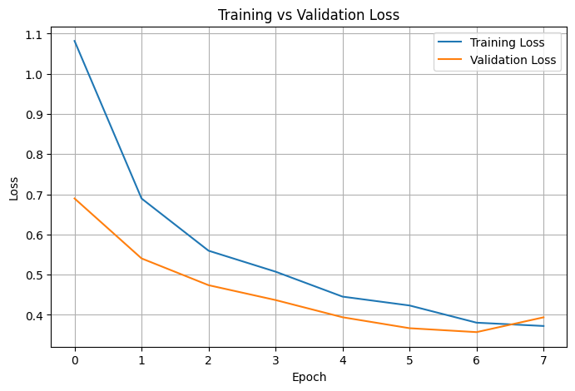
Output Visualization
Training and Validation Accuracy Graph.

Slide 19
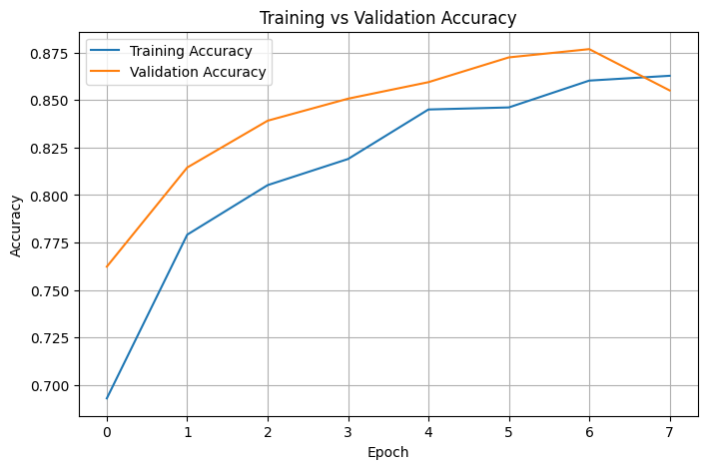
Output Visualization
Training and Validation Loss Graph.

Slide 20
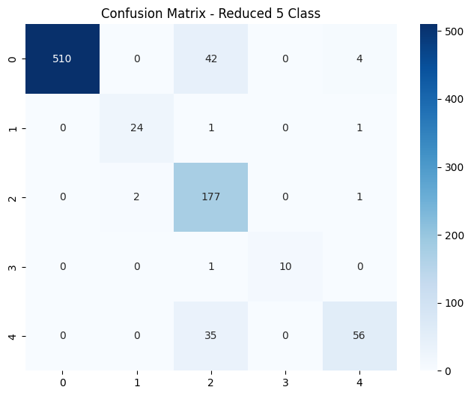
Output Visualization
Confusion Matrix for Five-Class Classification.

Slide 21
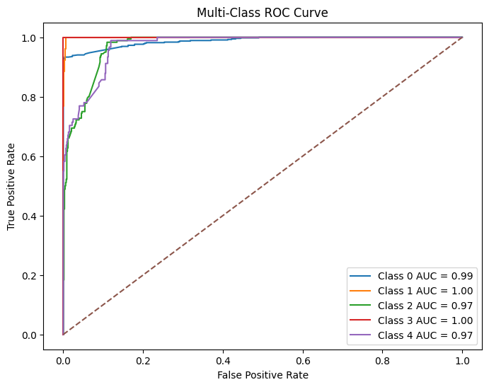
Output Visualization
ROC Curve

Slide 22
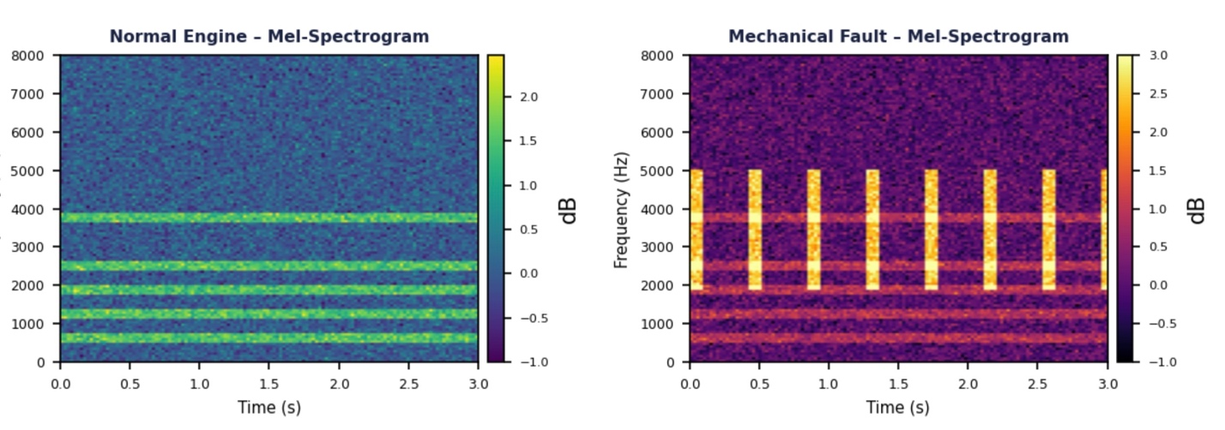
Output Visualization
Normal vs Faulty Egnine Mel-Spectrogram

Slide 23
Conclusion
This project successfully demonstrates that engine faults can be effectively detected using acoustic signals without relying on intrusive hardware sensors or complex diagnostic systems. The proposed approach utilizes Mel-spectrogram based feature extraction and CNN-based classification to analyze engine sound patterns under different operating conditions.
The developed model achieved strong classification performance and was able to accurately distinguish between normal and faulty engine states. The results validate the effectiveness of acoustic signal processing for non-intrusive engine fault diagnosis.
Overall, the proposed system provides a scalable, practical, and cost-effective solution for real-world engine monitoring and intelligent fault detection applications.

Slide 24
Future Scope
The proposed system can be further improved by using larger and more diverse datasets containing recordings from different engine configurations and vehicle types. Including multiple engine architectures and operating conditions would improve model robustness and generalization capability.
Future work may also focus on deploying the system as a mobile or web-based application for easier accessibility and practical real-world usage. Real-time engine fault detection can be implemented to continuously monitor engine conditions during operation.
The system can additionally be integrated with IoT-based vehicle monitoring platforms and smart automotive systems for automated diagnostics and predictive maintenance applications.
Further improvements in classification performance may be achieved by using more advanced deep learning architectures and larger training datasets.

Slide 25
References
TensorFlow Documentation: https://www.tensorflow.org/
Librosa Documentation: https://librosa.org/doc/latest/index.html
Scikit-learn Documentation: https://scikit-learn.org/stable/
NumPy Documentation: https://numpy.org/doc/
Pandas Documentation: https://pandas.pydata.org/docs/
SoundFile Documentation: https://pysoundfile.readthedocs.io/

Slide 26
References
Keras Documentation https://keras.io/
Matplotlib Documentation https://matplotlib.org/stable/
IEEE Xplore Digital Library https://ieeexplore.ieee.org/
Springer Research Publications https://link.springer.com/

Slide 27
Thank You
27

